Slide 1
Informal Employment in Transition Countries By HARTMUT LEHMANN
Lesson: Political Economy of Transition
Student: Kalogeorgou Rafaela Effrosyni
Matricola:1900077156
Date: 23/05/2019

Slide 2
What is informal employment?
There are two definitions:
The productivity based definition in which, informality in the labor market describes non- professional self-employed, unskilled workers, persons in marginal jobs, domestic and family workers, and workers in small ﬁrms with up to ﬁve employees are all considered informal workers.
The ‘legalistic’ or social protection considers non-compliance with the regulations of the state regarding labor laws and social security systems as the deﬁning characteristic of informality. Dependent workers who, in order to avoid paying taxes, do not pay social security and welfare contributions or are prevented from doing so by their employers, are considered informal.
The self-employed who do not register their activities with the state are also considered informal.

Slide 3
Introduction to informal employment
Informal employment is a phenomenon that many workers face in their daily life. These kind of employment in general does not provide any employment security or any protection in case of sickness and old age. Also, income smoothing might be absent and there is the probability of detection and punishment by the authorities.
Informal employment poses major challenges to policy makers.
An increase in the statutory wage in the formal sector will reduce formal employment but lead to a lower informal wage and higher informal employment.
Voluntary choice regarding jobs and particular attributes of these jobs, such as ﬂexible hours, working as a self- employed and being your own boss and putting a small value on social security beneﬁts, can be the reasons for remaining in or moving to the informal sector.
Informal labor market is divided into two categories (by Tokman & Fields):
an ‘easy-entry’ informal sector, which constitutes the involuntary segment,
an ‘upper-tier’ informal sector, where barriers of entry persist and in which participation is voluntary.
To test for labor market segmentation along the formal–informal divide, researchers have employed two main tools:
wage gap regressions and
the estimation of transition probabilities between labor market states.

Slide 4
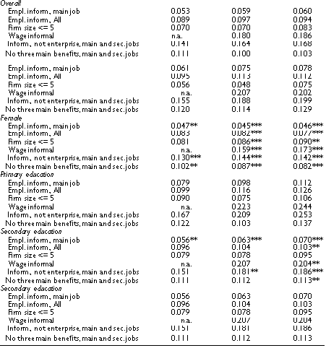
Table 1. Incidence of informal employment: overall and by gender, education and migration status by various deﬁnitions – Russian labor market.
Table 1 presents different measures of informal employment in Russia with the data sliced by gender and education. Τhe measures used for this research are:
The ﬁrst measure is narrow and includes only informal dependent employment at the main job.
The second measure is more general, including informal employees as main job holders, informal workers in a secondary job and all informal self-employed.
The third measure uses ﬁrm size as the deﬁning criterion.
The fourth measure is the share of all workers who receive all or part of their wages as ‘envelope payments’.
The ﬁfth measure of informal employment includes employees without a contract and those who do not work in an enterprise/organization in the main or secondary job.

Slide 5
Overall, Table 1 shows that the use of different measures of informality has different quantitative implications. The lowest incidence is given by dependent employees without a work/contract agreement in the main job (6% in 2011 relative to all employees), the highest numbers emerge if we use the deﬁnition based on envelope payments (around 19% in 2011) and the broadest employment-based deﬁnition that includes informal employees as well as those who do not work in an enterprise/organization (around 17% in 2011).
All measures apart from the one based on the lack of beneﬁts informal employment has increased over the crisis.
Workers with ‘envelope payments’ and informal employees, together with those not working in an enterprise/ organization, have the highest incidence, followed by the broad measure based on informal employment and on beneﬁts.
The measure of informal main job holders (dependent employees) has the lowest incidence.
In 2007 and 2011, female workers have a statistically signiﬁcant lower incidence of informal employment. Thus, like in other transition economies and in contrast to developing countries female workers are less likely to have an informal job than men.
When the criterion of ﬁrm size is used women seem to have a higher incidence of informal employment.
Educational attainment has a signiﬁcant impact on the rate of informal employment as the last four panels of Table 1 demonstrate. In 2011, apart from the measure based on ﬁrm size, workers with secondary education have a lower incidence than workers with only primary education. In addition, in all years, workers with higher education have a statistically signiﬁcant lower incidence of informal employment than workers with secondary education, no matter which measure of informal employment is used.

Slide 6
Figure 1: Share of informal employment by industry: Russia 2005 and 2011. Not ofﬁcially employed (without work contract/agreement) at the main job Not ofﬁcially employed and not in enterprise/organization at the main or second job
Figure 1 shows the distribution of informal employment by industry using the most restrictive and the most encompassing ‘legalistic’ deﬁnition in panels and respectively. Both panels demonstrate the large variation in the incidence of informal employment by sector, with construction, trade and related services showing by far the largest shares of informal employment. In addition, in light and food industry, transport, agriculture and in other sector we also ﬁnd a relatively large incidence of informal employment
The sector trade and related services still shows by far the highest incidence of informal employment whether we take ﬁve employees or less or ten employees or less as our measure.
Science and culture and Public administration exhibit relatively high shares of informal employment.
Informal employment decreases in age when we take the four ‘legalistic’ measures, but increases in age when we use the ﬁrm-size measure. On this last measure, male workers are less likely to be informally employed, while we ﬁnd a higher probability of informal employment for male workers in the case of the ﬁrst four measures.
Being married and more educated decreases the likelihood of being informally employed, no matter which measure of informal employment is used.

Slide 7
Figure 2 shows that:
some workers in public administration and science and culture are employed in small work units.
25% of workers in public administration are informally employed. Therefore while the measure using ﬁrm size equal to or less than ﬁve employees might be acceptable when trying to capture a large chunk of informal employment, the measure based on ﬁrm size equal or less than ten employees strikes us in the ﬁnal analysis as inappropriate.
The correlations between measures based on ﬁrm size equal to or less than ﬁve employees and ‘legalistic’ measures are small and insigniﬁcant. Therefore, the two types of measures cover different subsets of workers.

Slide 8
Which factors are the main determinants of informal employment? Are the identiﬁed determinants stable across a spectrum of different deﬁnitions of informal employment?
Table 2 shows the marginal effects across ﬁve deﬁnitions of informal employment for age, gender, marital status, educational attainment, regional location and residence type. Αccording to the data given in the table:
Informal employment decreases in age when we take the four ‘legalistic’ measures, but increases in age when we use the ﬁrm-size measure.
Male workers are less likely to be informally employed, while there is found a higher probability of informal employment for male workers in the case of the ﬁrst four measures. Being married and more educated decreases the likelihood of being informally employed, no matter which measure of informal employment is used.
Also, dependent employees in Moscow and St. Petersburg have a higher probability to be informal than their counterparts in the rest of the country.
Those who resident in a village, lower the probability of being informally employed for the ﬁrst four measures, while this probability is increased when the criterion of firm size is used.
In this table, the legalistic measure of registration of one’s job or activity is used to reﬁne the analysis of the drivers of informal and formal employment.
On behalf of that, the employment is divided in 5 stages:
involuntary informal dependent employment
voluntary informal dependent employment
informal self-employment*
formal self-employment
formal dependent employment.
*As already mentioned, we assume informal self- employment to be voluntary.

Slide 9
Marginal effects of a multinomial logit regression between the years 2004–2011 Table 3.
Men have a higher incidence of both dependent informal employment and informal self-employment
The marginal effects of age, marital status and educational attainment have opposite signs when we distinguish between dependent and self-employment: these factors increase the likelihood to engage in informal self-employed activities, but decrease it for both voluntary and involuntary informal dependent employment.
Immigrants from the Caucasus or Central Asia raises the likelihood of informal self-employment.
Immigrants from other parts of the former Soviet Union do not seem to be more involved in self-employment than natives, but seem to have a particularly high incidence of involuntary informal dependent employment.

Slide 10
Which should be the approach to the analysis of informal employment in transition countries?
Estimates of the incidence of informal employment depend crucially on the deﬁnition used. Researchers need to use a series of deﬁnitions or measures to produce a reliable picture of the extent of informal employment in an economy.
The use of non-professional self-employment as a measure of informality, as often done in the literature can be misleading in transition countries that start out with economies where the vast majority of workers are wage workers in formal jobs.
Third, ﬁrm size strikes to be a criterion of dubious value to pin down informal employment in transition countries since the correlations of workers in small ﬁrms and informal workers deﬁned on the basis of one of the ‘legalistic’ deﬁnitions are small and insigniﬁcant.
Authors believe that measures that are based on ‘legalistic’ criteria should be predominantly employed when analyzing the incidence and the determination of informal employment in transition countries.

Slide 11
Wage Gap
Wage gap along with the formal– informal divide, is very limited for transition countries. Evidence, which is based on cross-sectional data, is severely biased because of selection problem, like, unobserved characteristics such as ability or motivation might be important determinants of an individual’s selection into a formal or informal job.
Fixed effects estimates of wage differentials based on longitudinal data control for unobserved heterogeneity as long as the unobserved characteristics are time invariant and equally remunerated across jobs.

Slide 12
Pagés and Stampini analysis of wage.
Pagés and Stampini analyze wage differentials in three transition countries: Albania, Georgia, Ukraine.
The authors use cross-sectional and ﬁxed effects regressions and difference-in-differences analysis to investigate whether there is a premium for formal jobs or for informal jobs in the three countries. They perform this analysis distinguishing between skilled and unskilled workers.
The results of the analysis are:
The cross-sectional results establish a premium in informal jobs in Georgia for the unskilled and a formality premium in Ukraine across both skill levels. These results are overturned when longitudinal data are employed in the estimations.
In Georgia, the authors establish a wage gain for workers who change from formal to informal jobs, and this wage gain is larger for skilled workers than for their unskilled counterparts. Also in Georgia, workers seem to select themselves into informal jobs.
In Ukraine the formality premium disappears when unobserved characteristics are controlled for. Thus, in Ukraine, the formal wage premium comes about because higher ability workers select themselves into formal jobs and not because jobs are of higher quality in the formal sector.
In Albania the results show no premium independent of the estimation method used.
Thus, the evidence of Pagés and Stampini seems to point to integrated labor markets in the three analyzed transition countries.

Slide 13
Lehmann and Pignatti analysis of labor market segmentation.
The authors use the waves of 2003 and 2004 of the Ukrainian Longitudinal Monitoring Survey (ULMS)⁷ to analyze labor market segmentation in Ukraine. They estimate ﬁxed effects and difference in differences regressions. They, however, use more detailed information on labor market states, dividing employment into ﬁve mutually exclusive states:
Formal salaried
Voluntary informal salaried
Involuntary informal salaried
Formal self-employment
Informal self-employment
The ﬁxed effects regressions take on three forms:
simple ﬁxed effects regressions
ﬁxed effects regressions with a Heckman correction term for selection into employment categories
and a Hausman–Taylor version of ﬁxed effects
Observations:
All versions show positive wage differentials for voluntary informal salaried, formal self-employment and informal self-employment
There is no signiﬁcant difference in the wages of formal salaried and involuntary informal salaried workers
There is no difference in the growth rates of hourly wages for formal salaried and involuntary informal salaried workers
For the other three employment categories hourly wages grow more than for formal salaried workers. This growth differential is particularly large for the informally self-employed.
Low-skilled informal employees experience a statistically significant and economically meaningful wage penalty while informal employees with high skills have the same wages as their formal counterparts
The results on the Ukrainian labor market essentially say that once we control for self-selection into an employment state, the wage differential between the formal and informal sector disappears. They also imply that the informal sector is itself segmented since we ﬁnd a positive wage premium for those who voluntarily choose informality, that is, the voluntary informal salaried and the informal self-employed.

Slide 14
Figure 3 presents the hourly wage gap over the entire wage distribution for informal employees (panel a) and the joint set of informal employees and informal self-employed and entrepreneurs (panel b). The ﬁgure is based on simple quantile regressions that do not control for unobserved individual heterogeneity. The estimates of the wage gap are based on the simple quantile regressions.
Low-skilled informal employees experience a statistically signiﬁcant and economically meaningful wage penalty while informal employees with high skills have the same wages as their formal counterparts.
Figure 3 tells us that for highly skilled informal employees, having a share of roughly 30% of informal salaried employment, the labor market is integrated; in contrast, the majority of salaried informal workers, who have lower skills, are confronted with a segmented labor market in Russia.
When the self-employed and entrepreneurs to dependent employees is added there are some changes, the informal sector seems segmented in the sense of Tokman (1986) and Fields (1990) since we there is a lower part of the distribution with wage penalties (a free entry lower tier) and an upper part with positive wage differentials (an upper rationed upper tier).

Slide 15
Risk attitudes and informal employment
There are two papers analyzed about the risk attitudes and informal employment. The first one is by Dohmen and it focuses in the Ukrainian labor market and the second is by Lehmann and Zaiceva and focuses on the Russian labor market link risk preferences and selection into various labor market states among them informal employment. In both studies it is underlined that informal employment is an inherently risky state and that workers who have a higher tendency to take risks are more likely to consider informal employment.
In the ﬁrst study, the authors look at the relationship between risk attitudes and the decision to migrate, showing that individuals with a higher propensity to take risks are more prone to migrate. In the setting of a quasi-natural experiment in the Ukrainian labor market, Dohmen studies occupational sorting and establishes that workers with a larger propensity to take risk sort into occupations with higher earnings risk. In the third study, the authors ﬁnd that risk-takers are more likely to become and stay self-employed.
Types of risk attitudes measures that are recovered from these modules:
(a) self-assessed ‘subjective’ measures of risk preferences of the general type and speciﬁc to life domains
(b) ‘objective’ measures linked to hypothetical investment questions and
(c) lottery questions.

Slide 16
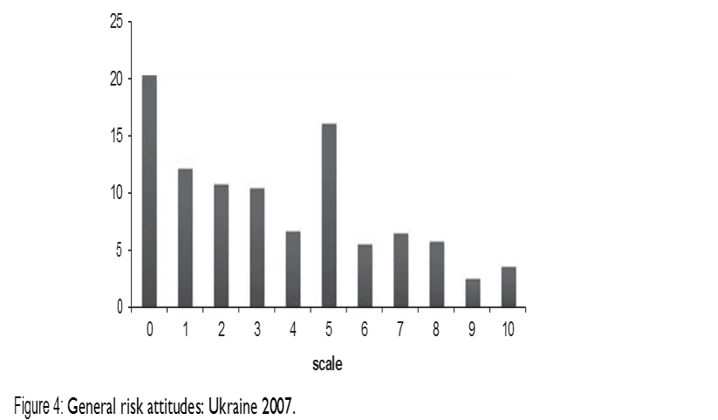
Figures 4 and 5 show the distributions for the general risk index in Ukraine and Russia.
Results:
In both countries, one-ﬁfth of workers are completely risk averse.
In Ukraine people tend to be more disinclined to take risks than in Russia.
Roughly three quarters of Ukrainian and Russian workers are relatively risk averse.

Slide 17
Figures 6 and 7 link risk attitudes to labor market states.
In both countries (Russia and Ukraine), formal employees are the most risk averse while the self-employed show the highest propensity to take risk. This is conﬁrmed by the averages of the risk index across labor market states and demographic characteristics shown in Table 5 for Ukraine.
No matter what the demographic characteristic, the average of the risk index is the lowest for formal employees, while the averages for informal employees and self-employed are more or less close to each other.
Workers who are voluntarily in informal dependent employment are more risk loving by roughly half a unit, while there is little difference in the average risk indices of the formally self-employed and the informally, that is not registered, self-employed.

Slide 18
Table 6 summarizes the results of regressing the probability of being in informal employment on various risk measures while controlling for demographics, income, migration status, sector, occupation and region.
Results
Being in informal employment continuously over a long period has no signiﬁcant effect on risk attitudes.
The upper panel of Table 6 shows the impact of general risk preferences and of risk preferences in the ﬁnancial domain for Russia. Whether the risk index or the risk indicator is used, we get statistically signiﬁcant positive marginal effects.
When the index increases by one unit, the probability of being in informal employment rises by 1/5 of a percentage point in the general and in the ﬁnancial domain.
When the dichotomous risk indicator is taken, the results tell us that a relatively risk-loving person has a propensity to select himself into informal employment that is between 1.3 and 2.2. percentage points higher than for a relatively risk-averse person.
In addition, the coefﬁcients on gender, education and regional location are of the same order of magnitude as the coefﬁcients on the risk indicator variables
The effects for Ukraine, shown in the lower panel of Table 6 are very similar to those for the Russian labor market and have similar relative magnitudes.
Risk preferences are important in predicting selection into informal employment in both countries.

Slide 19
Dividing employment into ﬁve distinct states (involuntary informal dependent employment, voluntary informal dependent employment, formal dependent employment, informal and formal self-employment) is an additional tool to ﬁnd out whether risk attitudes are indeed an important determinant of self-selection into a labor market state. When causality runs from risk attitudes to labor market state, dependent involuntary informal employment should not be determined by risk attitudes since workers do not enter this state by choice. On the other hand, we can assume that workers with a higher propensity to take risks are more likely to choose voluntary informal dependent employment or informal self-employment. Also it is thought that self-employment in general, whether informal or formal, is associated with a higher propensity to take risks

Slide 20
Estimates of relative odds ratios of a multinomial logit model are presented in Table 7 for Russia in 2009.
The general risk index has no predictive power regarding involuntary informal dependent employment but does have a positive impact on the likelihood of being a voluntary informal employee or being self-employed.
The positive relation between risk proclivity and self-employment is consistent.
When workers have a choice, their risk attitudes in addition to gender, age, marital status, educational attainment and house- hold income constitute an important factor that determines the chosen employment state.

Slide 21
Conclusions and Thoughts of the Authors
The authors conclude the research claiming that informal employment is widespread in transition economies and the topic is understudied and as a conclusion their knowledge about this phenomenon in the region is very limited
For policy makers, it is important to know the incidence and the determinants of informal employment
More work needs to be done before deﬁnitive statements are made about whether labor markets are integrated or segmented in transition economies
The new research area the authors introduce, links risk preferences and selection into labor market states, showing that if individuals have a choice, relatively risk-loving workers have an increased likelihood to choose informal employment and self-employment.

Slide 22
THANK YOU ☺

