Slide 1
Institutional determinants of labor reallocation in transition
Authors: Tito Boeri and Katherine Terrell
Student: Marina Novković

Slide 2
The transition process has been very different in the countries of the Former Soviet Union (FSU) and those of Central and Eastern Europe (CEE) in terms of:
reallocation of labor from the old sector to the new sector
responsiveness of employment to output changes
the extent of real wage decline

Slide 3
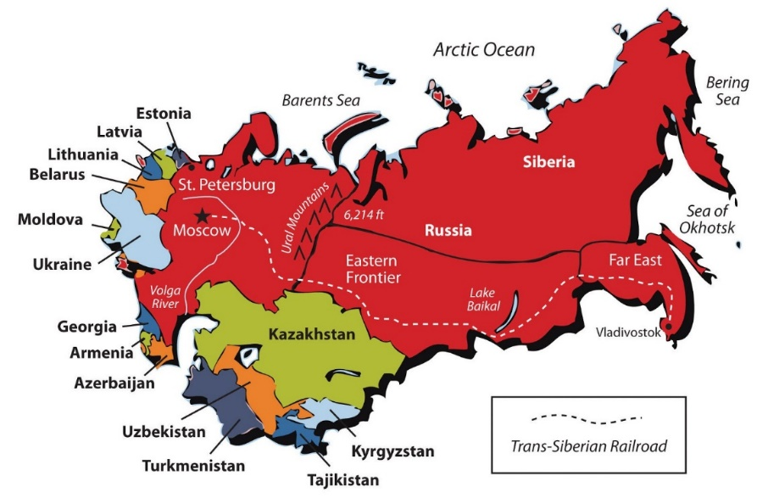
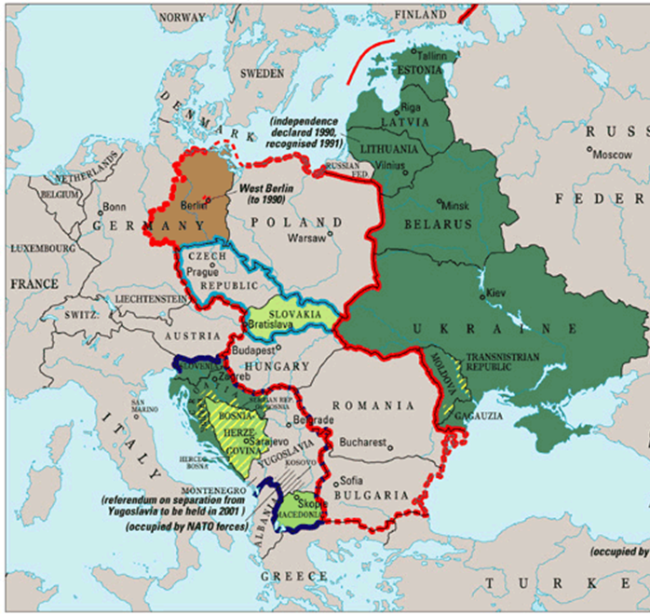
Initial conditions were similar in both groups of countries
Heavy industry was overdeveloped
Strong small business sector was lacking
Private initiative was tolerated exclusively in agriculture
Collapse of trade
External shocks
Former Soviet Union countries
Central and Eastern Europe countries

Slide 4
How can we explain those asymmetries?
Different economic policies?
Models of Optimal Speed of Transition?
Both are not relevant to the explanation of the differences between CEECs and FSU.
Thesis: cross regional differences in the generosity of non-employment benefits are consistent with different trajectories of labor market adjustment in the FSU and CEE countries.

Slide 5
Diverging adjustment trajectories
The CEECs GDP began recovering from the transitional recession in their fourth year (U-shaped trend).
FSU experienced a slower decline of employment than the CEECs and had to wait 10 years before experiencing a mild recovery in GDP (L-shaped trend).

Slide 6
Real wages: wages in terms of the amount of goods and services that can be bought

Slide 7
How much job reallocation has there been from the old to the new sectors in the CEECs and in the FSU?
The old sector is characterized along three dimension: - economic activity → industry and agriculture - ownership → state – owned enterprises - firm size → large conglomerations - non-agricultural self – employment did not exist or it was confined to the shadow economy.

Slide 8
1. Dramatic changes have occurred in the structure of employment over a short time period
2. Structural change is proceeding at a faster pace in the CEECs than in the FSU
3. There are asymmetries in adjustment trajectories within these two groups of countries

Slide 9
Two key points:
CEECs experience significant employment adjustment, fast structural change and high unemployment, mostly long-term.
FSU has a low responsiveness of employment to output changes, strong and persistent wage declines, slower structural change and a more gradual buildup of unemployment.

Slide 10
The models of Optimal Speed of Transition
These models can generate different equilibria depending on the pace at which governments succeed in engineering mass layoffs in state enterprises: - too rapid → job creation in the private sector is restrained by fiscal costs of unemployment (big bang strategy) - too slow → too costly to pull workers from the old state sector (gradual transition process)
Offer predictions qualitatively consistent with stock adjustment in these countries.

Slide 11
Critics to OST models
examples of Russia and Ukraine, Poland and Slovenia.
voluntary quits > layoffs.
fail to characterize important labor market flows and the stagnancy of transitional unemployment in the CEECs (table 2).
do not give enough importance to job-to-job movements.
ignore the role of wages as a determinant of the level of employment in the old sector.
facts suggest that separations from state sector employment were an endogenous variable rather than a policy instrument (as they were a by-product of voluntary choices of workers).
cannot frame the trade-off between employment and wage adjustment in the old sector.

Slide 12
Peu: the n. flowing from employment to unemployment as a proportion of the n. employed.
Peo or Puo: flows to Out of labor forces.
Pue: flows leaving unemployment for a job.

Slide 13
Role of wages
Wages are brought into play in the second phase of the OST model, but only as a function of unemployment.
Output declines did generate employment declines in the transition economies.
Greater wage declines moderated employment declines.
Adjustment in the FSU involved wages whereas in the CEECs it involved mainly employment.

Slide 14
Heterogeneity and Specificity: winners and losers of Transition
Individuals that are more likely to become unemployed and to experience more difficulty in moving out of unemployment: - low educated individuals - women - young people
Gender question → societal roles - maternity and child care leave is a cost for the new private sector and also for state enterprises under hard budget constraints - a reduction in government provision of free childcare in many countries contributed to a reduction of the labor supply of married women.

Slide 15
Education issue: the Mincerian earnings function
Returns to a year of education increased substantially from Communism to the early transition period.
Exception → former East Germany (it was forced to import labor market institutions developed in the West).
Gender gap: during Communism women had higher returns to education → now it has narrowed.
Notes:
Mincerian earning function: an equation model which explains wages as a function of education and experiences

Slide 16
The Marketability of education and work experience
General secondary school and tertiary education are highly and increasingly rewarded.
Lower vocational schools are poorly priced by the market mechanism (→ over-investment by previous regime and now are over-represented in the pool of unemployed).
Inflows into vocational education are declining.
Enrolments to general secondary are booming in all countries.
Work experience under central planning was not rewarded more with the transition: - older workers experiences’ during Communism are not being valued in the labor market.

Slide 17
Differences because of region of residence
At early stages of transition different types of regions negatively affected job finding probabilities and wages → recently asymmetries overlap with the urban/rural divide.
Labor supply is important in explaining the concentration of unemployment and non-employment in rural areas.
Why these disparities? - low interregional mobility - commuting flows
Notes:
Unemployed: a person who hasn’t got a job. Non-employed: a person who is not looking for a job.

Slide 18
Losers and winners
The winners:
young, educated, men, living in urban areas, with skills enabling them to exploit the opportunities offered in the emerging private sector.
The losers:
women and older workers, whose human capital has been devalued, and have low incentives to acquire the new skills that are relevant to the emerging market economy.
It is difficult for losers to become a winner due to regional imbalances in the allocation of employment opportunities and the narrow base of many vocational education curricula.

Slide 19
Labor market adjustment, earnings inequality and institutions
Transition involves the development of new job matches, using workers with different skills and labor market attachments.
Such differences were repressed by the previous regime.
Explosion of earning inequalities → mitigated by institutions imposing wage floors: - we expect transition to generate more unemployment (constrains to wage adjustment and low productivity workers are forced to leave the old sector) - the wage floor can inhibit the creation of low productivity jobs in the new sector - the less skilled workers are more likely to be unemployed than of the more skilled workers.
→ Labor market institutions are intermediaries of the transition.

Slide 20
Institutions and labor reallocation
There are 4 institutional features important for employment and wage setting: - unions - tax based income policies - minimum wages - employment protection legislation
There has been a large research on the impact of unemployment programs (active and passive) on the duration of unemployment and the probability of finding a job.

Slide 21
Unions
In the old system: - were not rooted at the workplace - transmission belts for authorities and not voices for workers - soft budget constraints - unprepared for wage negotiations and opposition to staff cuts
→Need to build new unions “from scratch”.
Strong declines in union membership.
Declines in coverage of collective bargaining.
Increase in segmentation of workers’ organizations (Czech Republic, Hungary → low representation, Russia → high representation – low effectiveness)
in the early part of transition voice of workers was heard through worker’s councils in CEECs (not in Czechoslovakia) and Russia, not in other in other FSU countries.

Slide 22
Tax based Income Policies (TIPs)
Scope: slow the wage growth.
Probably it had modest influence on wage levels because: → they were occasional, reducing the credibility of tax penalties and allowing for intervals of “wage catch-up” → they were designed to control the average wage of the firms, hence substitution was allowed within the firm → they were enforced in the large public enterprises and not in the new private sector.
By 1995 many of the CEECs abandoned them and Russia abolished them in 1996.

Slide 23
Minimum wages
In the CEECs were set at levels comparable to those in the West (45-50% of the average wage).
In Russia and Ukraine the ratios were 27% and 32% respectively.
They were consciously unaltered for several years during inflation period.
They were not binding during the transition.
They were de facto not used as a policy tool because they were not enforceable → weakness of bargaining institutions, lack of an efficient network of labor inspectors in these countries.

Slide 25
However, minimum wages had some indirect role: - they serve as the basis for calculating most social benefits - they may have influenced wage growth in the public administration in Russia.
Under Communism, employers could not easily layoff workers and at the beginning of the transition Labor Codes were revised for employment protection regulations and they consist mainly of transfers between employers and their employees: - severance pay - extension of the duration of the job BUT, there is a weak enforcement of these regulations.
Labor markets in CEECs and FSU have a relatively high flexibility.

Slide 26
Active labor market policies had an impact on the reduction of unemployment duration?
Boeri: “when interacted with cuts to benefit duration, active policies have had some impact on job finding probabilities and were relatively cost-effective”.
In 1993 in Czech Republic, the monthly cost of outflows from unemployment to jobs (induced by active policy) was of 4-7% of the average monthly wage, while an average unemployment benefit offered roughly the 30% of the average wage.
Other researchers did not find positive effects of active policies on unemployment outflows.
In other countries, active policies proved poorly targeted or associated with “policy circles”.
Terrell and Sorm (1999) found that active labor market policies in Czech Republic were targeted to the “hard to employ” population and they benefited from the program.
Notes:
Policy circles: participants in active schemes requalify for benefit payment

Slide 27
Unemployment benefits
Initially they were set at high levels and provided in some cases for unlimited duration.
Later on, they were tightened as the number of beneficiaries was excessive and fiscal consolidation was required.
The introduction of the maximum limit of benefits (140-180% of the minimum wage) also contributed to reduce benefit levels.
Unemployment benefits did not create strong work disincentive effects: the elasticity’s of unemployment duration with respect to changes in benefits ranges from 0.1 in Slovakia to 0.3 in the Czech Republic to 0.7 in East Germany and Hungary – moderate compared to the ones of U.S.A, Canada and Europe.

Slide 28
Non-employment benefits as wage floors
Weak unions and the lack of enforcement of minimum wages ended up assigning to unemployment benefits and to subsidies to non-employed individuals in working age a relevant role: they put floor to wage setting.
Table 4 displays summary statistics on non-employment benefits and earnings in the CEECs and FSU countries.
As we can see, there was a stronger increase in inequality in the FSU than in the CEECs.
Countries with lower levels of spending in non-employment benefits and replacement rates experienced the largest increases in the inequality earnings.

Slide 29
To sum up
There is a large difference between the CEECs and the FSU countries in: - the responsiveness of employment to output changes - the extent of real wage decline - the amount of reallocation of labor from the old to the new sector - the degree of wage dispersion - the timing of the rise of unemployment and its duration.
The model of social policy followed by CEECs gave greater role to non-employment benefits than the FSU countries, putting floors to wage distributions and preventing decline of wages and operating as a subsidy to job creation in the new sector.
Consequences of the wage floor in the CEECs: - old and inefficient firms were forced to discard their least productive labor rather than being allowed to adjust wages downwards or accumulate wage arrears - the new private sector made new jobs (as retail service sector) more attractive but more difficult for the least skilled workers to obtain, creating more unemployment among them.
In the FSU unemployment benefits were too low to be used as subsidies and there were marked entry barriers associated with mafia and smuggling.

Slide 30
Why were two different social policy models adopted by countries starting from similar initial conditions?
The most convincing explanation for these differences in policy models relates to the more or less strict conditionality and appeal of the EU social policy model vis-à-vis the transition countries.
The social policy model adopted in the CEECs allowed for faster structural change to occur, contributing to growth later on in the transition and less inequality but it depends on the type of institutions involved (remember the case of Eastern Germany, where the earning structure was compressed by imported centralized wage bargaining institutions)

Slide 31
Thank you for your attention

