Slide 1
Informal Employment in Post-Transition Countries - with an Emphasis on Russia and Ukraine
Hartmut Lehmann (University of Bologna and IZA)
Invited Lecture
XIX International Academic Conference on Economic and Social Development
12 April 2018 - NRUHSE, Moscow

Slide 2
Discussed themes
Introduction
Size of informal sector/shadow economy in post-transition countries
Incidence of informal employment in these countries
Should policy makers combat informality and informal employment (IE)?
Examples of policy instruments to combat informality and IE
Competing schools of thought of informal employment: segmented vs. integrated labor market
Empirics
Precise understanding of informal employment
Incidence of IE is a function of the definition: example Russia
Distribution of IE across industry and occupation by definition
Determinants of informal employment
Testing labor market segmentation in post-transition countries
Transitions between labor market states
Estimation of informal-formal wage gap
New research area: risk attitudes and informal employment

Slide 3
Size of shadow economy(in % of official GDP) – shadow economy = that part of economy not registered/ under-declared ≠ illicit activity
Country | 1999 | 2005 | 2010 | 2013
CEE
Czech Republic | 19.30 | 19.73 | 19.99 | 18.47
Hungary | 25.40 | 26.18 | 27.94 | 23.88
Poland | 27.70 | 23.37 | 28.48 | 26.62
Slovak Republic | 18.90 | 19.29 | 24.77 | 19.85
Slovenia | 27.30 | 26.90 | 29.01 | 29.49
Baltic States
Estonia | 33.00 | 22.48 | 37.82 | 22.94
Latvia | 30.80 | 23.59 | 31.07 | 19.92
Lithuania | 33.80 | 24.79 | 34.36 | 21.95
Bulgaria & Romania
Bulgaria | 36.00 | 32.49 | 37.30 | 35.55
Romania | 34.30 | 33.98 | 35.29 | 30.65

Slide 4
Size of shadow economy (in % of official GDP)
Country | 1999 | 2005 | 2010 | 2013
SEE
Albania | 35.70 | 42.15 | 47.21 | 51.96
Bosnia&Herzegovina | 34.30 | 38.82 | 37.13 | 36.45
Croatia | 33.80 | 25.91 | 30.34 | 31.61
Macedonia | 39.00 | 31.84 | 30.21 | 29.93
Serbia | 34.30 | 36.53 | 37.35 | 27.95
European CIS
Belarus | 48.30 | 51.44 | 41.66 | 37.67
Moldova | 36.00 | 49.41 | 70.66 | 55.80
Russian Federation | 36.00 | 44.45 | 45.64 | 46.37
Ukraine | 52.70 | 50.23 | 59.49 | 53.53

Slide 5
Size of shadow economy (in % of official GDP)
Country | 1999 | 2005 | 2010 | 2013
Caucasus
Armenia | 46.60 | 43.99 | 50.74 | 48.47
Azerbaijan | 61.00 | 44.41 | 45.43 | 46.54
Georgia | 34.00 | 49.97 | 61.46 | 53.20
Central Asia
Kazakhstan | 43.80 | 37.52 | 47.37 | 55.69
Kyrgyz Republic | 41.40 | 39.19 | 42.57 | 44.82
Tajikistan | 43.50 | 60.72 | 64.12 | 63.76
Source: Hassan and Schneider 2016

Slide 6
Informal employment: two main definitions
PRODUCTIVE/ILO DEFINITION: characterizes informality in the labour market by job characteristics
➔ Non-professionals, unskilled, marginal jobs, the self-employed, domestic and family workers and workers in small firms with up to 5 employees.
“LEGALISTiC”/SOCIAL PROTECTION DEFINITION: characterizes informality in the labour market by non-compliance to the state in terms of labour laws and social security systems
waged workers and the self-employed non-compliant or without access to the social security system or pension system, with no registration/contract.
(Source: Perry et al. 2007)

Slide 7
Incidence of informal employment in transition countries (various definitions)
Georgia (1999): 58% (see Barnabe and Stampini 2008)
Georgia (2012): 10% informal employees; 72% self-employed
Georgia (Tbilisi, 2013): 11.5% informal employees and 6.1% self-employed informal
Georgia (Tbilisi, 2015): 8.2% informal employees and 11.3% self-employed informal
China (2010): 20% to 37% (see Park et al. 2013)
Ukraine (2004): 9.3% informal employees and 5.4% self-employed informal
Ukraine (2012): 8.9% informal employees and 6.8% self-employed informal
Russia (2009): 10% to 35% (see Kapeliushnikov 2013)

Slide 8
Theoretical aspects of informal employment:
(A) The policy dimension: should policy makers care about informal employment and pursue formalization of informal jobs?
(B) The “academic dimension“: Are labor markets segmented along the informal-formal divide?

Slide 9
(A) Should policy makers care about informality and informal employment?
Equity considerations
Efficiency considerations
Limits of formalization: see, e.g., Elinor Ostrom and Ravi Kanbur

Slide 10
(A) Should policy makers care about informality and informal employment? Equity considerations
Free riding on public services and infrastructure
Because of free riding ↑ tax burden of formal employment ⇒ further ↑ in IE
Severe exploitation of workers with jobs that are often hazardous to their health

Slide 11
(A) Should policy makers care about informality and informal employment? Efficiency considerations
Informal sector & IE ⇒ little physical and human capital
Both physical and human capital important ingredients for growth (Lucas 1988)
Ceteris paribus, an economy with a larger formal sector and more formal employment has a larger average growth rate
Formalization is important to raise income levels of middle income countries in the medium run

Slide 12
(A) Efficiency considerations – a counter position:
Seminal work by De Soto (1979)
Small informal units are the vibrant part of a developing economy
Overregulation generates these informal units and prevents them to grow beyond a certain threshold and to become formal
Cost-Benefit calculation of formalization: Costs > Benefits ⇒ remain informal

Slide 13
(A) Policy responses to facilitate formalization
Macro evidence for ECA and LAC countries (Lehmann & Muravyev 2013)
Less regulation
Lowering the tax wedge
Micro evidence on benefit design from Koettl & Weber (2012) and Leibfritz (2011) – post-transition countries
disincentives for formal work are especially high for low-wage earners because of benefit floor
Tax wedge might not be a sufficient measure to capture disincentives for formal work

Slide 14
(A) Limits of formalization (see, e.g., work by Elinor Ostrom and Ravi Kanbur)
Guha-Kasnobis, Kanbur and Ostrom (2006) and papers in their volume as well as, e.g., Kanbur (2014) are critical of a dichotomous view of labor markets in developing countries along formal-informal divide; for Guha-Kasnobis et al. formal and informal are metaphors with context-dependent connotations.
More concretely, this strand of the literature puts policy at the center: what matters are policies that improve workers’ lives whether they are formal or informal and/or whether formalization of jobs or keeping jobs informal achieves such an improvement.

Slide 15
(B) Competing schools of thought on informal employment and labor market segmentation in developing countries
Distinguish between three schools of thought
Labor market segmentation with IE the bad state – workers are involuntarily in informal employment and queue up for formal employment - IE bridging function (Harris and Todaro 1970);
Labor market is integrated with workers locating themselves over working life in that segment that gives them highest utility – workers are voluntarily in informal employment (Maloney 1999, 2004)
Informal sector itself is segmented with a free entry lower involuntary tier and an upper rationed voluntary upper tier (Tokman 1986 and Fields 1990)

Slide 16
Empirical research regarding the two raised theoretical aspects of informal employment
For policy to work I need to know the incidence and the determinants of informal employment
Testing for labor market segmentation along the informal-formal divide w/r to post-transition countries

Slide 17
Incidence of IE = f (definition): Russian case total sample (main RLMS data)
3 main benefits: paid vacations, paid sick leave, maternity leave

Slide 18
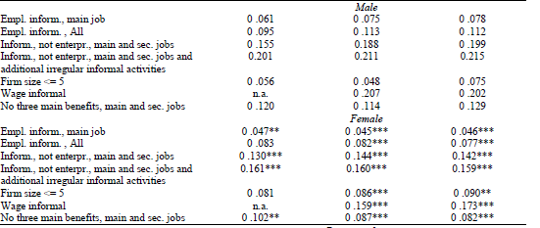
Incidence of IE = f (definition): Russian case by gender (main RLMS data)

Slide 19
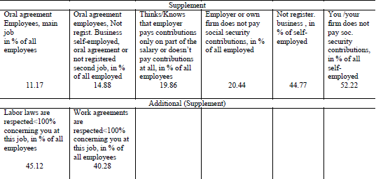
Incidence of IE = f (definition): Russian case definitions taken from RLMS supplement 2009

Slide 20
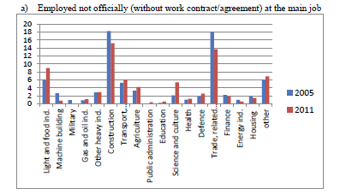
Distribution of IE across industry by legalistic definition (RLMS)

Slide 21
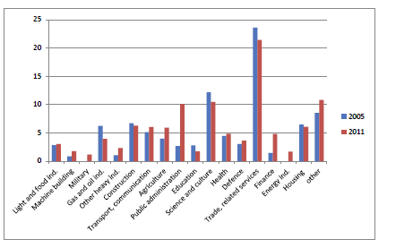
Distribution of IE across industry by firm size definition (RLMS)

Slide 22
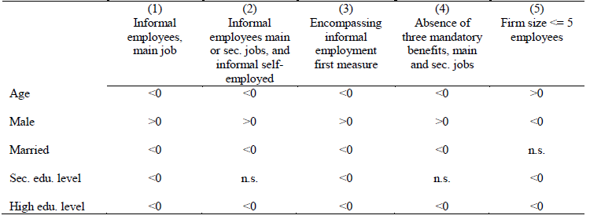
Determinants of IE by different definitions: signs of probit marginal effects (RLMS 2003 – 2011)
Apart from firm size measure we find robustness of determinants of IE – this is in contrast to the study of Kapeliushnikov (2012).

Slide 23
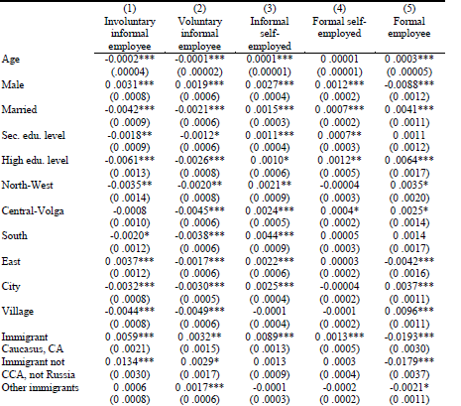
Determinants of employment subdivided into 5 subcategories: Multinomial Logit marginal effects (RLMS 2003 – 2011)

Slide 24
Testing for labor market segmentation: Analyzing transition probabilities

Slide 25
Medium-term transition probabilities – Ukraine (Lehmann and Pignatti 2018)
2003-2007
 | FS | VI | INVI | SEF | SEI | UN | OLF | Pi.
FS | 0.71 | 0.01 | 0.03 | 0.02 | 0.01 | 0.05 | 0.17 | 0.48
 | 0.01 | 0.00 | 0.00 | 0.00 | 0.00 | 0.01 | 0.01
VI | 0.49 | 0.00 | 0.23 | 0.13 | 0.05 | 0.03 | 0.08 | 0.01
 | 0.08 | 0.00 | 0.07 | 0.06 | 0.04 | 0.03 | 0.04
INVI | 0.43 | 0.04 | 0.09 | 0.07 | 0.07 | 0.09 | 0.19 | 0.02
 | 0.06 | 0.02 | 0.03 | 0.03 | 0.03 | 0.04 | 0.05
SEF | 0.15 | 0.02 | 0.06 | 0.61 | 0.03 | 0.02 | 0.11 | 0.02
 | 0.05 | 0.02 | 0.03 | 0.06 | 0.02 | 0.01 | 0.04
SEI | 0.38 | 0.03 | 0.09 | 0.13 | 0.19 | 0.09 | 0.09 | 0.01
 | 0.09 | 0.03 | 0.05 | 0.06 | 0.07 | 0.05 | 0.05
UN | 0.43 | 0.03 | 0.10 | 0.03 | 0.05 | 0.03 | 0.32 | 0.14
 | 0.02 | 0.01 | 0.01 | 0.01 | 0.01 | 0.01 | 0.02
OLF | 0.37 | 0.02 | 0.05 | 0.03 | 0.01 | 0.10 | 0.42 | 0.32
 | 0.02 | 0.00 | 0.01 | 0.01 | 0.00 | 0.01 | 0.02
P.j | 0.54 | 0.02 | 0.05 | 0.04 | 0.02 | 0.06 | 0.27
N | 3,225
Italic entries: bootstrapped standard errors.

Slide 26
Testing for labor market segmentation: Analyzing transition probabilities – complementary evidence
Pages and Stampini (2007): find high mobility from informal and formal salaried jobs, for informal and formal self-employed no clear pattern (Albania, Georgia and Ukraine).
Bernabe and Stampini (2008): support for segmentation in Georgia, preference for formal employment over informal work which seems to serve as a buffer in recessions.

Slide 27
Analysis of transition probabilities for Russia (Slonimczyk and Gimpelson 2015)
The only study that comes to different conclusions on segmentation in a post-transition economy is by Slonimczyk and Gimpelson (2015). Their mobility analysis of the Russian labor market along the formal-informal divide finds segmentation either to be very attenuated or non-existent once one controls for unobserved time-invariant characteristics.
Hence according to this study the labor market in Russia is integrated.

Slide 28
Testing for labor market segmentation: wage gap analysis
We start out with pooled OLS and pooled quantile regressions of the following generic type:
At the mean:
$y_{it}=$ ${{γ_{t}+x}^{′}}_{it}β$ + $δ{VI}_{it}$ + $ρ{INVI}_{it}$ + $θ{SEF}_{it}$ + $θ\left(τ\right){SEI}_{it}$ + $U_{it },$
$U_{it }\sim white noise$
Across the entire distribution:
$F_{y_{it}}^{−1} \left(τ | x_{it}\right)=γ_{t}\left(τ\right)+{x^{′}}_{it}β\left(τ\right)+δ\left(τ\right){VI}_{it}+ρ\left(τ\right){INVI}_{it}+θ\left(τ\right){SEF}_{it}+θ\left(τ\right){SEI}_{it}+ U_{it }, U_{it }\sim N\left(0,1\right),$
$$τ ∈ \left[0,1\right]$$
These relatively simple models are then extended to include fixed effects, i.e., to control for time-invariant unobserved heterogeneity.

Slide 29
Hourly wage gap regressions at the mean (OLS & FE) – Ukraine 2003-2007 (Lehmann and Pignatti 2018)

Slide 30
Quantile hourly wage gap regressions with fixed effects – Ukraine 2003 – 2007 (Lehmann and Pignatti 2018)
 | q10 | q20 | q30 | q40 | q50 | q60 | q70 | q80 | q90
 | Entire sample (7,486 obs.)
Voluntary Informal | 0.015 | 0.184*** | 0.197*** | 0.066** | 0.235*** | 0.065 | 0.293*** | 0.071** | 0.206**
 | (0.050) | (0.057) | (0.013) | (0.030) | (0.050) | (0.102) | (0.067) | (0.034) | (0.102)
Involuntary Informal | -0.068*** | -0.055 | -0.035* | -0.163*** | -0.011 | -0.022 | -0.105*** | -0.093*** | 0.032
 | (0.021) | (0.040) | (0.019) | (0.038) | (0.022) | (0.026) | (0.030) | (0.023) | (0.041)
Self-Employed Formal | 0.286*** | 0.316*** | 0.516*** | 0.572*** | 0.564*** | 0.550*** | 0.296** | 0.619*** | 0.580***
 | (0.045) | (0.032) | (0.023) | (0.019) | (0.074) | (0.076) | (0.128) | (0.040) | (0.079)
Self-Employed Informal | 0.372*** | 0.215*** | 0.458*** | 0.434*** | 0.437*** | 0.456*** | 0.675*** | 0.389*** | 0.468***
 | (0.129) | (0.046) | (0.046) | (0.033) | (0.080) | (0.040) | (0.074) | (0.067) | (0.076)

Slide 31
The mean informal-formal hourly wage gap in Russia

Slide 32
Quantile wage gap regressions with fixed effects, Russia, 2004-2011
 | Q10 | Q20 | Q30 | Q40 | Q50 | Q60 | Q70 | Q80 | Q90
Invol. inf. employee | -0.0399 (0.0319) | -0.0492** (0.0240) | -0.0399* (0.0216) | -0.0515** (0.0227) | -0.0189 (0.0278) | -0.0098 (0.0222) | -0.0261 (0.0232) | -0.0276 (0.0241) | -0.0522* (0.0279)
Volunt. inf. employee | -0.0121 (0.0348) | -0.0051 (0.0366) | -0.0017 (0.0246) | -0.0403 (0.0285) | -0.0268 (0.0262) | -0.0001 (0.0222) | -0.0135 (0.0255) | -0.0258 (0.0271) | -0.0713** (0.0303)
Informal self-empl. | -0.0246 (0.0225) | -0.0218 (0.0166) | -0.0070 (0.0172) | -0.0018 (0.0188) | 0.0120 (0.0162) | 0.0389** (0.0156) | 0.0345** (0.0174) | 0.0491*** (0.0168) | 0.1092*** (0.0237)
Age | 0.0742*** (0.0077) | 0.0849*** (0.0058) | 0.0861*** (0.0059) | 0.0850*** (0.0054) | 0.0831*** (0.0056) | 0.0792*** (0.0055) | 0.0731*** (0.0056) | 0.0739*** (0.0060) | 0.0645*** (0.0095)
Age^2 | -0.0008*** (0.0001) | -0.0009*** (0.0001) | -0.0009*** (0.0001) | -0.0009*** (0.0001) | -0.0009*** (0.0001) | -0.0008*** (0.0001) | -0.0008*** (0.0001) | -0.0008*** (0.0001) | -0.0007*** (0.0001)
Married | -0.0269 (0.0179) | 0.0192 (0.0160) | 0.0333** (0.0152) | 0.0413*** (0.0137) | 0.0304** (0.0139) | 0.0351** (0.0139) | 0.0574*** (0.0149) | 0.0391** (0.0164) | 0.0465** (0.0208)
Sec. Edu. | 0.0033 (0.0279) | -0.0301 (0.0248) | -0.0468** (0.0216) | -0.0424* (0.0241) | -0.0493** (0.0220) | -0.0739*** (0.0229) | -0.0728*** (0.0199) | -0.0507* (0.0262) | -0.0324 (0.0360)
High edu. | -0.0102 (0.0573) | 0.0417 (0.0422) | 0.0204 (0.0360) | 0.0030 (0.0377) | -0.0022 (0.0328) | -0.0427 (0.0372) | -0.0120 (0.0319) | 0.0044 (0.0367) | 0.0433 (0.0476)

Slide 33
Conclusions I
Informal employment in formerly centrally planned economies is clearly an important issue that should be more researched
Before governments devise policies to combat informal employment researchers should provide a picture of informal employment that is as complete as possible
Keeping in mind the important point that not everyone chooses the labor market state s/he is in researchers need to understand what drives workers to self-select into a given state
Regarding labor market segmentation the dichotomous scenario existing in Latin America is less clear cut in the two post-transition countries (dependent vs. self-employed informal workers)

Slide 34
Risk Attitudes and Informal employment
New research area

Slide 35
Risk attitudes and informal employment Motivation
Risk attitudes should be an important determinant of the decision where to locate in the employment spectrum
Informal employment is inherently more risky (detection by authorities and no insurance against shocks and old age)
Our prior: more risk-loving persons have a greater propensity to choose informal employment than their more risk-averse counterparts
The existence of a nexus between risk attitudes and informal employment can shed light on the issue of labor market segmentation
Risk behaviour and the relationship to informal-formal labor market choice have hardly been studied in the literature – due to data limitations

Slide 36
Risk attitudes and micro behavior in the literature
Risk attitudes and its links to gender, age, migration were studied by Dohmen et al. 2005 and Jaeger et al. 2009 in the German context (females and older people are more risk-averse; people more willing to take risks are more likely to migrate).
Risk-taking behavior and the link to entrepreneurship in Russia was studied by Djankov et al. 2005 (entrepreneurs in Russia are more risk-loving than other economic agents). In a developing country context risk attitudes and labour markets (de Mel, McKenzie and Woodruff 2008ab).

Slide 37
Data that make the analysis possible: linking direct measures of risk attitudes and informal employment, also w/r to its voluntary/involuntary nature
Ukrainian longitudinal monitoring survey (ULMS)
Panel data set
Waves in 2003, 2004, 2007 and 2012
Special risk module (modelled after GSOEP)
Informal employment ascertained in reference weeks of the 4 waves – including its voluntary/involuntary nature
(see Lehmann, Muravyev and Zimmermann 2012)
RLMS main data set 2009
RLMS supplement 2009: same risk module as in ULMS (see Lehmann and Zaiceva 2013)

Slide 38
Different measures of risk attitudes from risk module (ULMS 2007 and 2012 and RLMS supplement 2009)
‘Subjective’ risk attitudes measure (1. general, 2. life domain specific)
‘Objective’ risk measure (Hypothetical Investment question)
Lotteries
➔ Here, we focus on the first one.

Slide 39
Questions soliciting Risk Attitudes (self-evaluation): General (1) and financial domain (2)
How do you see yourself? Are you generally a person who is fully willing to take risks or do you try to avoid taking risks? Please give a number from 0 to 10, where the value 0 means: “Completely unwilling to take risks” and the value 10 means “Completely willing to take risks”. You can take the values in between to make your estimate.
People can behave differently in different situations. How would you rate your willingness to take risks in financial matters? (0 to 10 as before).

Slide 40
Risk attitudes (RLMS supplement 2009)

Slide 41
Risk attitudes (RLMS supplement 2009)

Slide 42
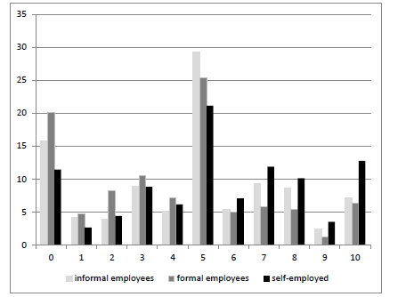
General risk attitudes and employment state: RLMS supplement 2009

Slide 43
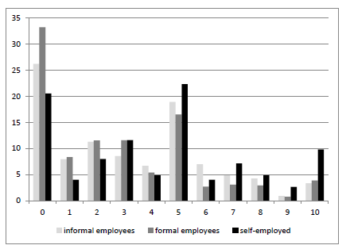
Risk attitudes in financial domain and employment state: RLMS supplement 2009

Slide 44
Risk attitudes Ukraine 2007 & 2012

Slide 45
Risk attitudes Ukraine 2007 & 2012 by employment category

Slide 46
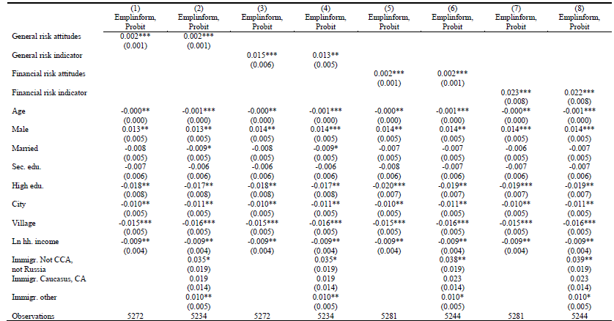
Risk measures and informal employment – main job Russia (RLMS supplement 2009)

Slide 47
Probit Analysis: General Risk and Informal Employment in Ukraine – 2007
 | Dependent variable: 1 if in informal
 | (1) | (2) | (3) | (4) | (5) | (6)
 | 2007 | 2007 | 2007 | 2007 | 2007 | 2007
Willingness to take risks (standardized) | 0.014*** | 0.014*** | 0.011*** | 0.029*** | 0.029*** | 0.023***
 | (0.005) | (0.005) | (0.004) | (0.007) | (0.007) | (0.006)
Age/10 | -0.025 | 0.016 | 0.006 | -0.033 | 0.047 | 0.044
 | (0.035) | (0.034) | (0.027) | (0.052) | (0.052) | (0.046)
Age squared/100 | 0.001 | -0.003 | -0.001 | 0.002 | -0.007 | -0.005
 | (0.004) | (0.004) | (0.003) | (0.006) | (0.006) | (0.005)
1 if Ukrainian | -0.012 | -0.012 | -0.009 | -0.008 | -0.007 | -0.007
 | (0.011) | (0.011) | (0.009) | (0.017) | (0.017) | (0.015)
1 if female | -0.018* | -0.021** | -0.019** | -0.036*** | -0.044*** | -0.039***
 | (0.010) | (0.010) | (0.008) | (0.014) | (0.014) | (0.012)
1 if married | -0.049*** | -0.047*** | -0.030*** | -0.065*** | -0.064*** | -0.038***
 | (0.011) | (0.010) | (0.009) | (0.016) | (0.015) | (0.014)
No. of children in household | 0.005 | 0.005 | 0.004 | -0.000 | -0.001 | 0.003
 | (0.006) | (0.006) | (0.005) | (0.009) | (0.008) | (0.007)
Education:
General secondary | 0.012 | 0.016 | 0.010 | 0.017 | 0.027 | 0.030
 | (0.030) | (0.028) | (0.023) | (0.044) | (0.043) | (0.038)
Vocational | -0.012 | -0.007 | 0.005 | -0.031 | -0.018 | 0.014
 | (0.028) | (0.027) | (0.021) | (0.042) | (0.041) | (0.036)
Higher | -0.036 | -0.025 | -0.011 | -0.091** | -0.068 | -0.024
 | (0.030) | (0.028) | (0.023) | (0.044) | (0.043) | (0.038)
Log(adjusted household income) | -0.002 | -0.003 | -0.001 | -0.014* | -0.015** | -0.015**
 | (0.005) | (0.005) | (0.004) | (0.008) | (0.007) | (0.007)
1 if not employed between 2004 and 2007 |  | 0.062*** | 0.057*** |  | 0.123*** | 0.123***
 |  | (0.011) | (0.010) |  | (0.016) | (0.014)
1 if informal in 2003 or 2004 |  |  | 0.112*** |  |  | 0.251***
 |  |  | (0.015) |  |  | (0.017)
Columns 1-3 with sectors, columns 4-6 without; regions included in all columns

Slide 48
General risk attitudes and informality: MNL estimates – relative odds ratios (Russia 2009)

Slide 49
Conclusions II
We find that workers who are in voluntary informal employment relationships or in formal and informal self-employment to be more willing to take risks than formal employees and informal involuntary employees (for latter group result not that strong, though).
Risk attitudes are an important determinant for selection into informal employment relationships (significant and positive).
This link between risk attitudes and selection into informal employment points to an integrated labor market for many of the workers in the Russian and Ukrainian labor markets (and not only for the self-employed).
A person who takes risks in general and in career matters has a higher probability to be informal than a person stating to be relative risk averse.
Risk plays as important role as age/household income, while gender, education, job history and marital status play a larger role

