Slide 1
Women in Transition: Change in Gender Wage Differential in Eastern Europe & the Former Soviet Union
Jasmine Maria Cutajar & Laura Scicluna • University of Bologna - Campus of Forli

Slide 2
THIS PAPER
The author focuses on the question: ‘ Is the introduction of market reforms in former socialist countries a gender-neutral policy?’
Using:
Household surveys
Published data from a wide range of countries
This paper examines the gender wage gap within 1 to 2 years of the introduction of market reforms in each country. This statistic in itself does not capture the full range of women’s experiences in transitional countries.
Written by Elizabeth Brainerd

Slide 3
Suggestive evidence when testing correlation between the gender wage gap & extent to which each country had liberalised its internal and external markets (1994) measure by de Melo et al.’s (1997) – cumulative liberalization index
Higher value of index reflects greater progress in economic liberalisation, taken to indicate a greater degree of competition faced by firms
Statistically significant positive relationship between the post-reform level of gender wage ration and liberalization index
Simple correlations cannot prove that competitive pressure on firms – narrowed the wage gap in some countries
o Suggestive that gender discrimination has eroded by the forces of competition in Eastern Europe
o Women in Russia and Ukraine may benefit from the continue de-monopolisation and liberalisation of those economies

Slide 4
Government policies — encouraged women to work
high minimum wages
generous maternity leave
day care benefits
Female labor force rates were higher in Socialist countries of Eastern Europe and the former Soviet Union.
Women were still over-represented in sectors such as health and education.

Slide 5
Labor Market Institutions and Female Labor Market Performance Under Socialism
After the introduction of Central planning, the female workforce started expanding. (1930s-1940s)
Authorities encouraged women due to the demand of female labor - guarantee of the right to equal pay for equal work.
Encouragement to work to earn family income:
Maternity benefits
Day care centres
Low average wages
By international standards the female labor force was at an all time high.
Most women endured the double burden of both jobs and doing the bulk of the housework.

Slide 6
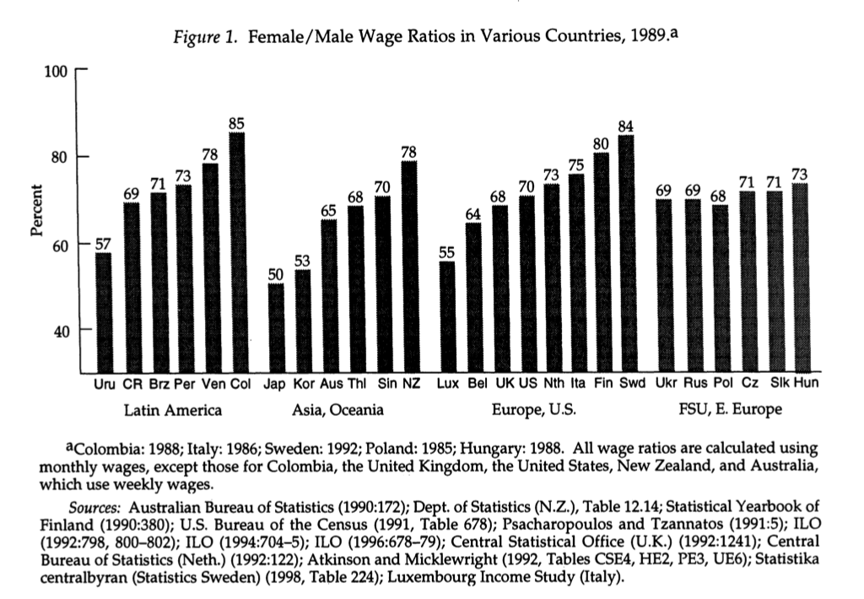

Slide 7
Socialist countries managed to create an equal labor market for both men and women.
Figure 1: Mean female-male wage ratio for Eastern Europe Countries and the former Soviet Union in 1989
Women in Socialist countries did as well as other countries
Example: United States at 70% compare to Russia at 69%.

Slide 8
Wages as interpretations of skill - man and a woman with the same percentage in the male wage distribution are viewed as equals by employers.
Higher mean female ranking:
improvements in women’s measured and unmeasured skills,
Decreasing discrimination against women.
By the male wage distribution measure, Eastern European countries did not do as well as Western countries.
The only means by which women would reduce their working time was to work in sectors like health, education and retail trade. These ‘low priority’ jobs were better due to more flexibility with hours.

Slide 9
Market Reforms and Changing Labor Market Institutions in the Early 1990s
Typical reforms in most countries:
Wage and price liberalisation
Trade liberalisation
Privatisation of state-owned enterprises
Tax and legal reforms.
Initiated major reforms in 1990 and 1991 - creating institutions for a market economy.
Russia:
almost resulted in hyper-inflation
Privatised its state-owned enterprises more rapidly than other countries.

Slide 10
How might the changing labor market institutions affect women?
The factors that influence the gender wage gap can be split into two:
Those related to changes in the overall wage structure
Changes in gender specific factors such as discrimination and relative levels of labor market skills.
The changes due to the reforms in previously Socialist countries are likely to have an impact on both factors.
Value of skills will change and some might favour women over men.
Women’s wages will also be affected by gender discrimination.

Slide 11
The role of the Wage Structure & Labour Institutions
Ukraine and Russia
Inequality in wages is very high
Extreme widening of the lower half of wage distributions
Low levels of minimum wage
Ukraine has high wage inequality as that of the developing countries (i.e. Great extremes of wealth and poverty)
Eastern European Countries
The wage structure in Eastern European Countries widened for both men and women
Increase in wage dispersion contrasted in the upper half of the wage distribution (Poland and Hungary). While it was more symmetric in Czech Republic and Slovakia .
High minimum change

Slide 12
And what about Women ?
Eastern European Countries
Female wages to be more protected in the lower part of the wage distribution here than in Ukraine and Russia
Increase in wage dispersion
Widening of wage structure penalised women in Eastern Europe led to favourable changes in the gender-specific factors
Narrowing of the gender gap in these countries
Favourable changes in gender-specific factors more than offset this effect
Women are more than likely to earn the minimum wage over men.
Russia and Ukraine
Penalise women more in Russia and Ukraine
With the widening of the wage structure explains the deterioration of female relative wages in Ukraine and Russia

Slide 13
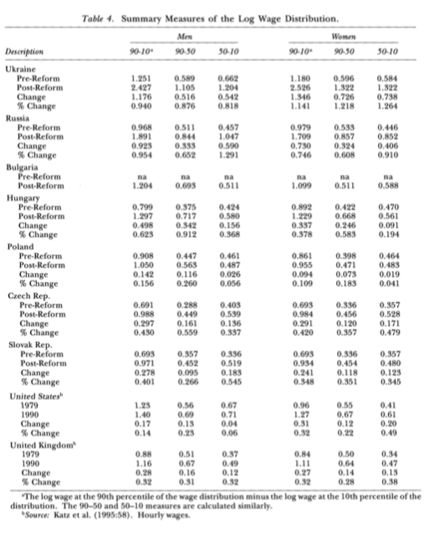

Slide 14
Wage Structure
Russia and Ukraine wage structure widened more dramatically
Differing labour market institutions
Dismantling the centralised wage-setting system allow the previously distorted wage structure to freely adjust to reflect scarcities and regards accordingly
Most countries, replaced the centralised wage -setting with new institutions that had potential to distort the wage structure in new ways
Narrowing the wage structure :
Impositions of tax based income policies
Indexation of minimum wages
Emergence of minimum wages
Emergence of collective bargaining arrangements

Slide 15
Institutional arrangements across these countries are diverse and labour market policies have been implemented with different effects, countries with the most decentralised wage-setting system (Russia and Ukraine). The greatest increase in wage inequality over the period
less unequal wage distributions those with effective incomes policies, collective bargaining arrangements and relatively high minimum wages
Differing changes in wage inequality – related to differing initial levels of macroeconomic disequilibrium across countries
Difficult to provide statistical evidence on this hypothesis – it does appear that wage inequality is higher in countries of the former Soviet Union – experienced well-known, dramatic shortages of consumer goods in late 1980s
Initial disequilibrium will result in greater labour market adjustments in response to price and wage liberalisation
It will create more opportunities for workers to earn rents in early years of transition

Slide 16
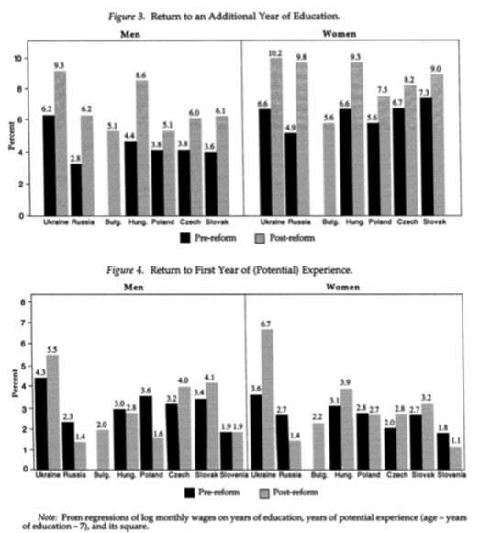
Since women have close to the same levels of what is considered ‘potential’ labour market experience as do men, this price change will likely explain little of the change in the relative wages.
Notes:
In Figure 3 we see the change in return to education for both men and women. Women are more likely than men to return to educational means. On average women are highly educated, with an increase to the female to male ratio. It is not the case that the relative return to education for women increased more in Eastern Europe than in Russia and Ukraine. With the differing changes in the returns to education are unlikely to explain the differing experiences between the two regions. In Figure 4; the return to First Year of (Potential) Experience, the result is very much mixed -- decreasing in countries like Poland and Russia but increasing in other countries.

Slide 17
Widening Wage Structure in these countries
Change in return to labour market skills
Improvements in female relative wage in Eastern Europe
Change in return to education for men and women
Women earn higher returns in education than men
Women continue to earn higher returns to education should increase the female to male ratio
Differing changes in returns to education are unlikely to explain the differing experiences in the region
Changes in return have been mixed
Women have close to the same levels of potential labour market experience as men - Price change will likely explain little of the change in relative wage

Slide 18
Decomposing the Change in the Female-Wage Difference
The change in the gender wage differential can be decomposed into changes due to gender-specific factors (observable skills and discrimination ).
As well as the widening of the wage structure
The first technique was first developed by Juhn, Murphy and Pierce (1991)
Blau And Kahn (1997)
Used to examine changes in gender wage differentials in the US
Compare international differences in gender wage differentials
Decompose the gender wage differential into these components
Male wage equation for period t highlight the role of wage inequality can plan in explaining relative pay differences, traditional factors of discrimination & differences in observed and unobserved skills

Slide 19
Male Wage Equation for Period t
W_{mt} – log of monthly wages
X_{mt} – vector of explanatory variables
B_{t} – vector of coefficients
O_{t –} standard deviation of the residual of male wage equation
0_{mt}- standardised residual of the male wage regression with mean 0 and variance 1 (that is 0_{mt}=e_{mt} / O_{t} where e_{mt} is the residuals from the male wage equation)
Illustrates the two components that comprise the residual : the percentile the individual occupies in the residual distribution 0_{mt}.
Spread of the residual distribution itself represented by O_{t.}
This conceptual distinction is exploited by the JMP decomposition technique

Slide 20
Male / Female Wage Gap Equation
Reflects the wage a women’s would receive if her skills were rewarded at same rate at which men’s skills are rewarded
Deflated by the male standardised residual
The gender wage gap in given period comprises an effect due to differences in observed skills between men and women
Weighted by the return received by men to these skills
Effect due to differences in the standardised residual
Weighted by residual male inequality

Slide 21
Change in the Gender Gap between two periods t and t
³ ‘Observed X’s’ – reflects changes in the gender wage differential result from changes in the male-female differences in observes labour market skill (level of education/ years of work experience)
³ Observed Prices effect captures the contribution of changes in the prices that the labour market attaches to observed skills of men
³ If wage distribution in these countries was artificially compressed under socialism and rewards for observed skills increase as wage determination is decentralised
³ Those with more skills will benefit disproportionately

Slide 22
Eastern European Countries
Women have higher levels of education than do men
Will benefit more from increased returns to education
The pattern of changes in returns to education appears to be broadly similar across countries
Component unlikely to explain the difference outcomes between Eastern Europe and former Soviet republics

Slide 23
‘Gap’ Effect - Blau and Kahn
Contribution of changes in the relative position of women in the male residual wage distribution
Women will move up in this distribution if their unobserved labour market skills improve relative to men’s / labour market skills improve relative to men’s
Labour market discrimination against women declines
Decomposition techniques is most valid when men and women are affected in similar way by labour market institutions and other factors that influences the wage distributions (table4)
Seems clear both the levels and changes in inequality are similar for men and women in countries of Eastern Europe / former Soviet Union
Institutional and market forces have affected men and women similarly in these countries
Appropriate to use this technique to analyse the changes in the gender wage differential in these countries

Slide 24
Fourth Term - Unobserved Prices
Measures the change in the gender gap attributable to the widening / narrowing of the distribution of male wage residuals
Holding constant the gap in male-female unmeasured skills
Reflects the contribution of the widening of the male residual distribution, holding constant the mean female ranking in the male residual distribution

Slide 25
Decomposition
This ‘Decomposition’ technique is most valid when men and women are affected in similar ways by labour market institutions & other factors which influence wage distribution. It suggests that institutional and market forces have affected men and women similarly in these countries and that it is appropriate to use this technique to analyse such changes in gender wage differentials in these countries.
Took place in : Ukraine, Russia, Hungary,Poland, Czech, Slovak Republics
Results along with those for Eastern Germany, Estonia and Slovenia (Table 5)
Same decomposition is presented for the US (1979-88) for comparison
Positive Figures indicate factors that have decreased female wages relative to male wages over the period
Negative Figures indicate factors that have improved female relative wages
Comparing across these countries highlights the substantial differences in the forces affecting Russia and Ukraine as compared with the East European countries

Slide 26
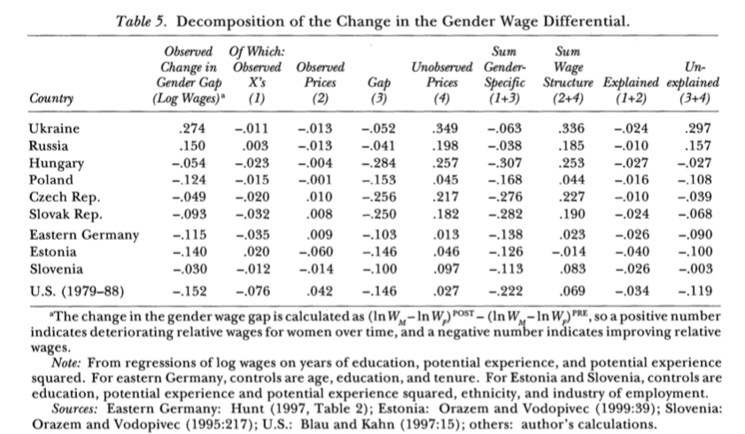

Slide 27
Russia and Ukraine
Changes in returns to observed skills (column 2)
Small relative gains in the mean female rank in the male residual distribution (column 3)
Contributed to improvements in female wages relative to male wages
Positive forces were more than offset by the adverse impact on women of the extreme widening of the wage distribution (Column 4)
Changes in the wage structure alone account for more than 100% of the deterioration in the female-male wage differential in these countries
Widening of the wage structure also worked against women in Eastern Europe – more than offset by women moving up in the residual male wage distribution (Column 3)

Slide 28
Remarkable improvement in the mean female percentile as the male residual distribution indicates
o Women are now subject to less discrimination in the labour market than previous
o Women’s unobserved labour market skills have improved relative to men’s
o Due to supply and demand shifts that have adversely affected men relative to women
o Demand and supply indexes - suggest that relative supply and demands shift unlikely to explain a large part of these changes
o Improvements in observed labour market skills contribute to higher female relative wages in all of the East European countries – but the effects are small relative to the ‘Gap’ effect (Column 1) t
o Factors that contributed to the declining gender gap in Eastern European countries – similar to factors that decreased the gender wage gap in US (recent years)
o Women’s wages in US improved relative to men’s wages largely because of improvements in female observed relative to male skills gender-specific factors

Slide 29
Eastern Europe :
Women’s relative wage gains in US occurred despite their ‘swimming upstream’ against a widening wage structure that adversely affected female wages relative to male wages
The US widening wage distribution reclaimed about 1/3 of the improvement in female relative wages ( sum of wage structure components divided by the sum of the gender specific components)
Increase in wage dispersion reclaimed as 4/5 of improvement in women’s relative wages in Eastern Europe
Decline in female relative wages in Russia and Ukraine

Slide 30
Changes in Female Employment and Labour Force
Differing shifts in the occupational and industrial distribution of employment between men and women
Changes in the relative labour supply of men and women – affect the gender wage gap
Data is very limited vable to construct indexes to reflect changes in relative labour demand (by industry) & supply for Russia, Hungary, Poland)
Effect of between-sector-demand shifts on relative labour demand – measured by fixed-coefficient ‘man power requirements’ index ( measure the percentage change in demand for a given group as weighted average of percentage employment growth by industry
Weights are industrial employment distribution for the given group in the base period

Slide 31
Change in Supply Measured
Ek1 - represents the share of total employment in the post-reform year of group k,
Eko - share of employment of the groups in the base (pre-reform) year

Slide 32
Changes in net supply
Direction of demand and supply shifts in all countries is consistent with the observed change in the gender wage gap
Russia – where female relative wages fell – net supply of women role while that of men fell
Hungary & Poland – net supply of women fell while that of men rose – this is consistent with the rising relative wages observes in those countries
Magnitude of those shifts small in comparison with those occurring in US in 1980s
Demands and supply shifts explain some – change in the gender wage gap in these countries
Data is limited these indicated do not account for occupation / within industry demand shifts likely to explain the change in gender wage gap
Labour force participation rates between men and women account for some of the changes in the gender wage gap across countries

Slide 33
Hunt (1997)
Eastern Germany – low skilled women dropping out of the labour forces disproportionately during transition an artificially increase female relative wages
Appears to be a factor in explaining the narrowing gender wage gap om Eastern Germany
Unlikely to contribute significantly to the rising female relative wages in countries survey here
Many countries the decline in male labour force participation rates nearly matched the decline in female labour force participation rates
Ukraine, Russia, Bulgaria and Poland there is a decline in male labour force participation in the early years of transitions exceeds that of female labour force participation
Changes in the relative supply of female workers unlikely to explain the changes in gender gap in most of these countries

Slide 34
1990s - ILO definitions
1993-94 female unemployment rates were not uniformly higher than male unemployment rates were not uniformly higher than male unemployment rates in the region
No systematic patterns in unemployment by gender in those countries
Male & female unemployment rates were roughly equal in 4 countries ( Ukraine, Russia, Bulgaria & Slovak Republic)
Female unemployment rates exceeded male rates ( Poland and Czech Republic)
Male rates were higher than female rates (Hungary and Slovenia)
Possible change in labour market discrimination à persisted in Russia and Ukraine – declined in Eastern Europe (Gap effect in Table 5)

Slide 35
Definitions given by the ILO
Employed
All persons in working age who during the reference period were either:
a) At work (performing work for a wage or salary, or for profit or family gain, in cash or in kind, for at least one hour)
b) With a job or enterprise but not at work (temporarily absent from work)
Unemployed
All persons in working age who during the reference period were
a) Not employed
b) Immediately available to start work and who had actively looked for a job at some time during the preceding four weeks

Slide 36
Conclusion
The introduction of market reforms in formerly socialist countries is not a gender-neutral policy. Reforms have affected women in variety of ways
Unequal burden of the economic restructuring in Russia and Ukraine
Narrowing of gender wage difference à consistent despite the difficulties of moving to a market economy, women have benefitted relative to men in the labour market in the region
Some similar forces were operating in the former Soviet republics, large magnitude of the increase in inequality in Russia & Ukraine, coupled with the lack of an effective minimum wage in those countries, prevented women from gaining in relative terms
Female relative wages – depressed by the increase in inequality in Eastern Europe (more than offset by improvements in gender-specific factors

Slide 37
Women in Eastern Europe face less labour market discrimination
Market reforms in Russia and Ukraine benefited women in ways outside of the labour market
Tremendous increase in the availability of goods and services in these countries since introduction of market reforms which eliminated the once-legendary need to spend hours standing in line to obtain food to feed one’s family
Freed a significant amount of time in non-market work that was formerly required of women
Changing the economic status of women a broader implications for economic growth
Shift in wage distribution away from women in some countries and towards women in others, will likely have consequences for the distribution of income within families.
Women have higher marginal propensity than men do to spend money on goods which benefit children Thomas (1990)
Resulting decline in investment on human resources in Russia and Ukraine (negatively affect) the long-run growth rates of economies
Re-allocation of wages towards women in Eastern Europe – serve to promote long-term growth in the area.

