Slide 1
The effects of Privitization and the Ownership in Transition Economies
S. Estrin, J. Hanousek, E. Kocenda and J. Svejnar
Eugenio Pagliero
Margherita Facente

Slide 2
Central topic: the analysis of the impact of privatization of SOEs

Slide 3
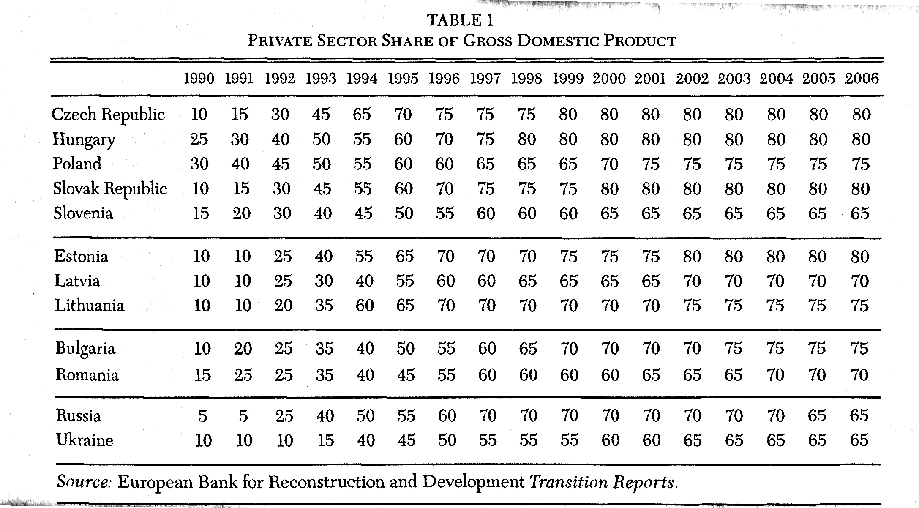

Slide 4
The Literature Approach
Early Literature:
analysis of the different domestic owners
FDI not so common till mid 90s
New Literature:
Domestic vs. Foreign ownership
Privatized vs. De novo enterprises
Concentrated vs. Dispersed ownership
Policies and istitutional development

Slide 5
We can distinguish the impact of privatization on the main indicators:
-EFFICIENCY
-PROFITABILITY
-REVENUES
-EMPLOYMENT
Etc.

Slide 6
Structure of the paper:
Thoretical and institutional issues raised by privatization
The macroeconomic evidence about the impact of privatization
Analysis of the privatization process on different indicators of company performance

Slide 7
2. Theoretical and Institutional issues
Early 90s-> Privatization as a keystone of the entire Transition Process
The Washington Consensus emphasized it.
Privatization on its own may not be sufficient.
Systemic Changes and Policy Reforms are a prerequisite for a successful transition.

Slide 8
Policies in Transition Economies
Svejnar distinguishes :
Type I Reforms
Almost in all countries of CEE and CIS
-Macrostabilization
-Price liberalization
-Dismantling institutions of the communist system
Type II Reforms
More rapid in CEE
-Development and enforcement of laws
-Regulation
-New institutions

Slide 9
Privatization and Efficiency
Early 80s : Privatization advocated as
->clear property rights
->economic incentives
->stimulation of superior economic performance

Slide 10
Privatization and Efficiency - 2
Main Arguments that support privatization:
Inefficient dimension of SOEs and gains from their divestiture and privatization
Central planning is not necessarily consistent with profit maximization

Slide 11
Privatization and Efficiency - 3
Other topics
Corporate governance
Impact of Oligarchs
Budget constraints
Welfare dilemma

Slide 12
Extent and methods of Privatization
How much, by what methods and at what rate privatization should be undertaken

Slide 13
Extent and methods of Privatization - 2
Arguments for Fast Privatization:
Firms become more competitive, price liberalization and other reforms would not provide sufficient incentives to SOEs
The State would not be able to resist intervening in SOEs
Avoiding risk of decapitalization

Slide 14
Extent and methods of Privatization - 3
Arguments for Gradual Privatization:
The political backlash caused by the mass privatization could be unacceptable.
Less impact on employment

Slide 15
Selection of firms to be privatized
Government may choose to sequence the privatization fo SOEs taking in consideration :
Transaction and congestion costs
Political opposition and uncertanty
Unemployment

Slide 16
Selection of firms to be privatized - 2
Competing government objectives for privatization:
-Maximizing Pareto efficiency
-Maximizing public goodwill
-Minimizing political costs
-Maximizing efficiency through information gains
-Maximizing privatization revenues

Slide 17
Selection of firms to be privatized - 3
Gupta, Ham and Svejnar found that firms in downstream industries and in industries with greater demand uncertanty were more likely to be privatized early.
This supports the argument that governments tend to privatize first firms that require flexible management.

Slide 18
3. Privatization and Growth
Patrick Plane-> privatization and economic growth
Berkowitz and Dejong-> large-scale privatization and development
Zinnes, Eliat and Sachs -> importance of the complementary reforms

Slide 19
Privatization has a positive effect on economic growth, when accompanied by complementary reforms.
BUT it’s unclear the effect of speed and the accompanying dispersed vs. more concentrated ownership on aggregate output and growth

Slide 20
4. The Effects of Privatization on the Performance of Firms
Selection of studies: only studies employ fixed effects or instrumental variables
  Less likely to suffer from selection bias
34 Studies (14 from Djankov and Murrell, plus 20 others)
Graphical presentation of results

Slide 21
Performances measured
Total Factor Productivity
Total Factor Productivity Growth
Profitability
Growth in Profitability
Revenue level
Growth in Revenue
Labour Productivity
Employment
Wages
Other Indicators

Slide 22
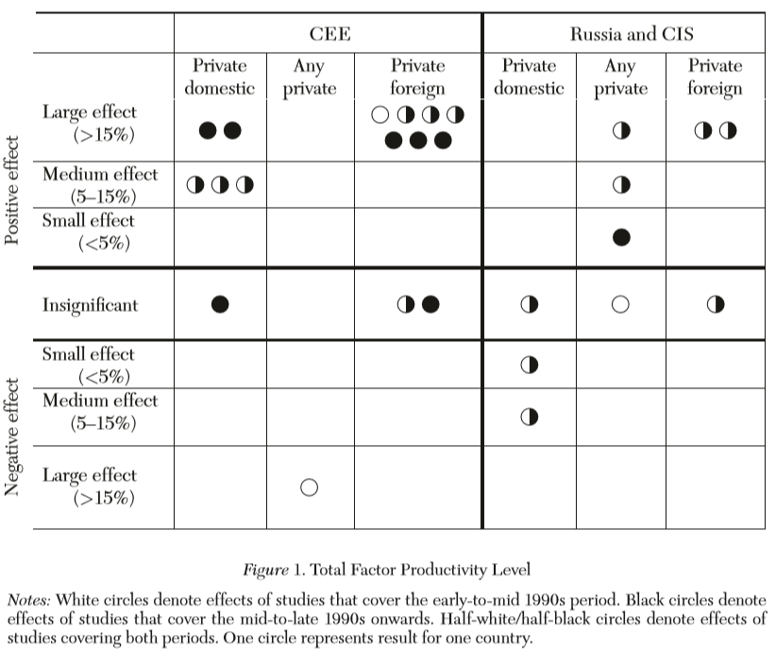
Total Factor Productivity (17 studies)
CEE: Positive effects of private ownership
  Stronger effect of foreign ownership than of domestic ones
  Greater in later than in earlier period
CIS:
  Positive or insignificant effect of foreign ownership
  Negative or insignificant effect of domestic ownership

Slide 23
TFP - 2
Strong positive effect of foreign ownership in CEE and CIS
Small positive effect of domestic ownership in CEE and Ukraine
Negative effect of domestic ownership in Russia and other CIS countries

Slide 24
TFP - 3
From the results, it is possible to say:
The hypotesis that concentrated private ownership increase efficiency more than dispersed one can find support
The effect of insider ownership on efficiency is insignificant (6 studies) or positive (1 study, Estonia)
De-novo firms are more productive than/as productive as SOEs privatized to domestic owners (2 studies)

Slide 25
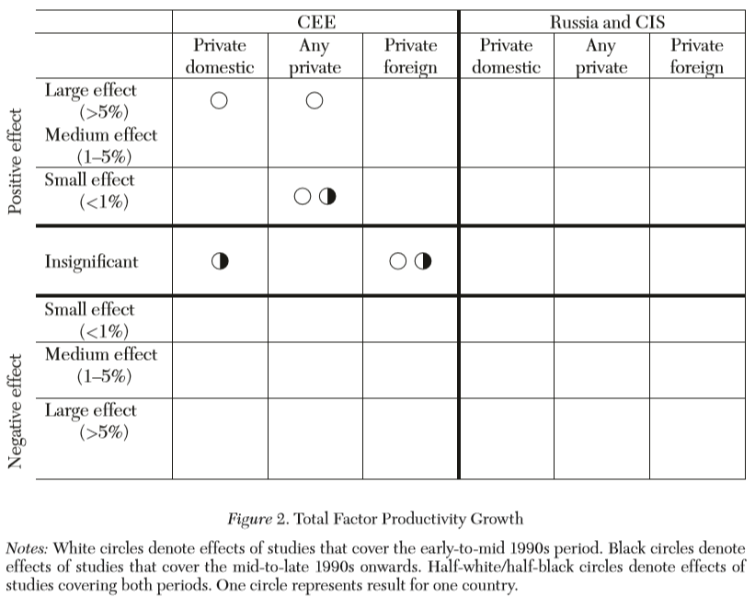
TFP Growth Rate
CEE :
  Positive in early transition period
  Insignificant in late transition period
Commander and Svejnar, referring to the period 2002-2005, obtained an insignificant effect in CEE and CIS for privatization to both domestic and foreign owners

Slide 26
TFP Growth Rate - 2
Immediate increase of foreign owned firms TFP g-rate in the early 90es.
Later, the rate become similar for all kinds of ownership

Slide 27
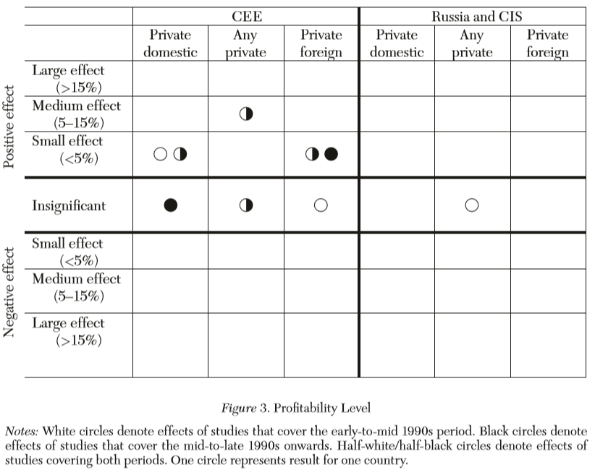
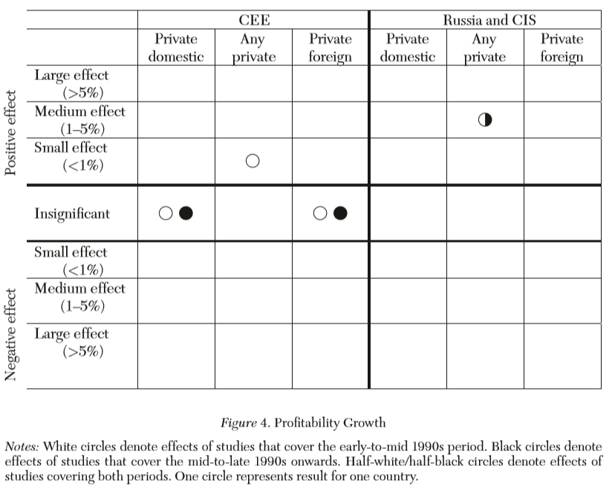
Profitability (10 studies, mostly CEE)
Small positive or insignificant effects on profitability levels
Insignificant effects on profitability growth rates

Slide 28
Profitability - 2
Effects vary across sectors
  Positive: industrial firms & foreign ownership
              financial activities & domestic ownership
Concentration effects
  Concentrated domestic private ownership ; managerial ownership = positive effects
  Concentrated foreign ownership = smaller positive effects
  State keeping a golden share; concentration of worker ownership = insignificant correlation

Slide 29
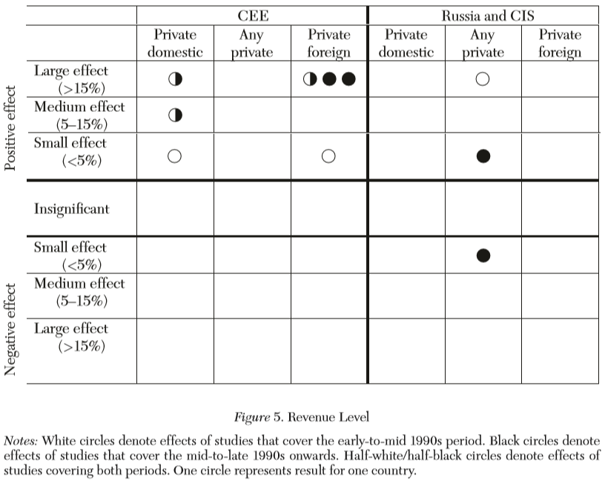
Revenues (14 studies)
CEE: strong positive effect
  Foreign ownership appears to have greater positive effects than domestic ownership
  Studies from early period have smaller positive effects than those of late period
CIS (only 3 studies)
  Evidence of strong positive effect, early period
  Evidence of small positive and negative effects, late period

Slide 30
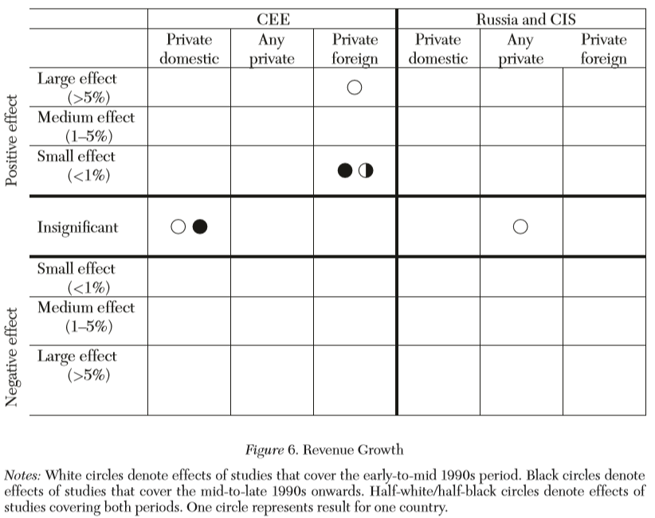
Revenues Growth Rates
CEE
  To foreign owners
    High positive effect, early period
    Small positive effect
  To domestic owners
    Insignficant

Slide 31
Labour Productivity (24 studies)
→Similar to TFP results
CEE & CIS: Private ownership has positive or insignificant effects
  Foreign ownership; concentrated ownership = positive/insignificant effects
  Employee ownership; managers ownership = mostly insignificant
  Ex-novo firms have lower/same LP than SOEs
  Government Golden Share= Insignificant

Slide 32
Employment (13 Studies)
CEE & CIS: Privatization is not related to an uprise in unemployment
  Private owners tend to keep employment at high levels

Slide 33
Wages (5 Studies)
Lower wages in some countries (Russia, former Czechoslovakia)
But
Not in others (Poland)
In Russia, private ownership had greater adherence to contracts than SOEs

Slide 34
Other Indicators (In total, 35 studies)
Private owned firms tend to have higher performances on exports and efficiency
Foreign firms:
  Tend to restructure and sell assets more than SOEs
  Are more to pay dividends
  Are less likely to default on debts

Slide 35
5. Conclusions
“The evidence [...] suggests that privatization and performance are related but that relationship is more complicated than has been assumed” (p. 24)
Privatization to foreign owners results in better performances
Privatization to domestic owners has been less impressive and with differences across regions

Slide 36
Further Conclusions
Concentrated ownership has stronger positive effects than dispersed one
Worker ownership does not have negative effects
New firms are equally or more efficient than firms domestically privatized
Foreign start-ups are more efficient than domestic ones
Privatization is not associated with a reduction in employment
Privatization may have a positive effect on the level of aggregate output and economic growth

Slide 37
Further Conclusion - 2
Domestic vs foreign owners
Limited skills and access to markets of local managers
Incidence of performance-reducing activities in domestically privatized firms
Influence of the privatization process on domestic ownership

Slide 38
Tips for Privatization
The results higlight the importance, for a successful privatization, of
Good management and corporate governance
Access to world markets
A functioning legal and institutional framework

Slide 39
THANKS FOR YOUR ATTENTION

